Slide 1
OPTIMIZATION TECHNIQUES

Slide 2
OPTIMIZATION TECHNIQUES
LINEAR OPTIMIZATION
NONLINEAR OPTIMIZATION

Slide 3
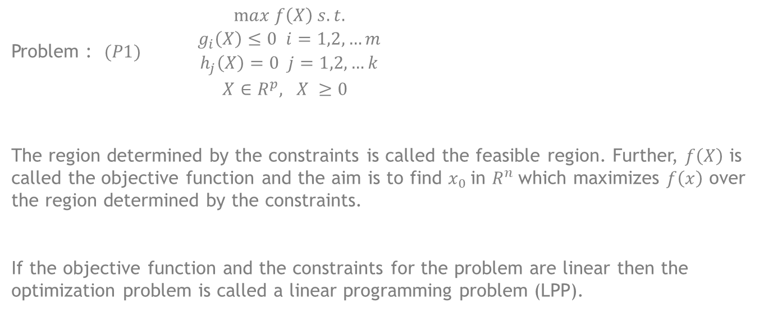
CONSTRAINED OPTIMIZATION
Problem : $(P1){\begin{aligned}max f\left(X\right) s.t. \\ g_{i}\left(X\right)≤0 i=1,2,…m \\ h_{j}\left(X\right)=0 j=1,2,…k \\ X∈R^{p}, X ≥0 \end{aligned}}$
The region determined by the constraints is called the feasible region. Further, $f\left(X\right)$ is called the objective function and the aim is to find $x_{0}$in $R^{n}$which maximizes $f\left(x\right)$ over the region determined by the constraints.
If the objective function and the constraints for the problem are linear then the optimization problem is called a linear programming problem (LPP).

Slide 4
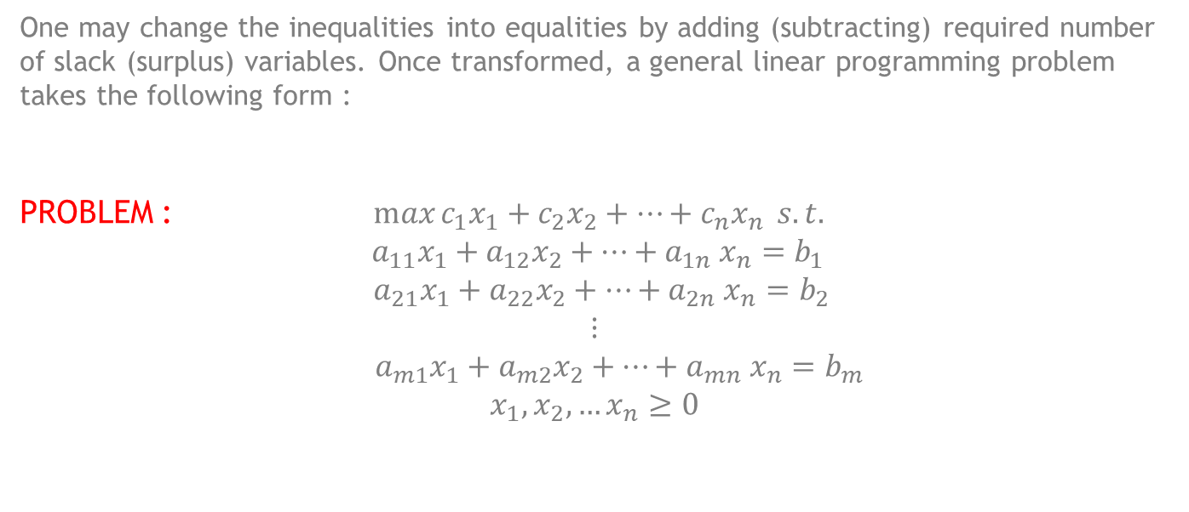
LINEAR OPTIMIZATION
One may change the inequalities into equalities by adding (subtracting) required number of slack (surplus) variables. Once transformed, a general linear programming problem takes the following form :
PROBLEM : $\max{c_{1}x_{1}+c_{2}x_{2}+…+c_{n}x_{n}} s.t.$
$$a_{11}x_{1}+a_{12}x_{2}+…+a_{1n} x_{n}=b_{1}$$
$${ a}_{21}x_{1}+a_{22}x_{2}+…+a_{2n} x_{n}=b_{2}$$
$$⋮$$
$${ a}_{m1}x_{1}+a_{m2}x_{2}+…+a_{mn} x_{n}=b_{m}$$
$$x_{1},x_{2},…x_{n}≥0$$

Slide 5
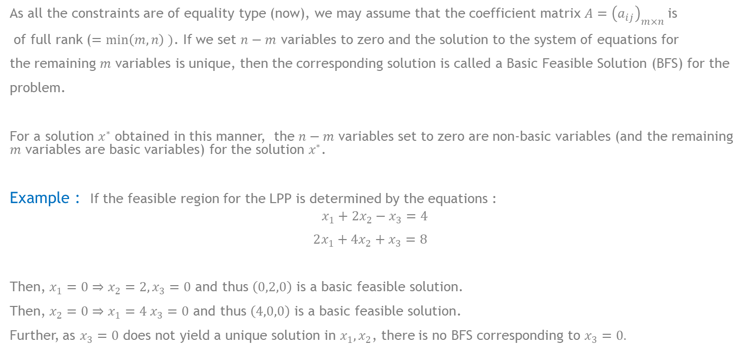
Finding Solution to an LPP
As all the constraints are of equality type (now), we may assume that the coefficient matrix $A={\left(a_{ij}\right)}_{m×n}$is
of full rank ($=\min\left(m,n\right) )$. If we set $n−m$ variables to zero and the solution to the system of equations for
the remaining $m$ variables is unique, then the corresponding solution is called a Basic Feasible Solution (BFS) for the
problem.
For a solution $x^{∗}$ obtained in this manner, the $n−m$ variables set to zero are non-basic variables (and the remaining $m$ variables are basic variables) for the solution $x^{∗}$.
Example : If the feasible region for the LPP is determined by the equations :
$$x_{1}+2x_{2}−x_{3}=4$$
$2x_{1}+4x_{2}+x_{3}=8$
Then, $x_{1}=0⇒x_{2}=2, x_{3}=0$ and thus $\left(0,2,0\right)$ is a basic feasible solution.
Then, $x_{2}=0⇒x_{1}=4 x_{3}=0$ and thus $\left(4,0,0\right)$ is a basic feasible solution.
Further, as $x_{3}=0$ does not yield a unique solution in $x_{1},x_{2}$, there is no BFS corresponding to $x_{3}=0.$

Slide 6
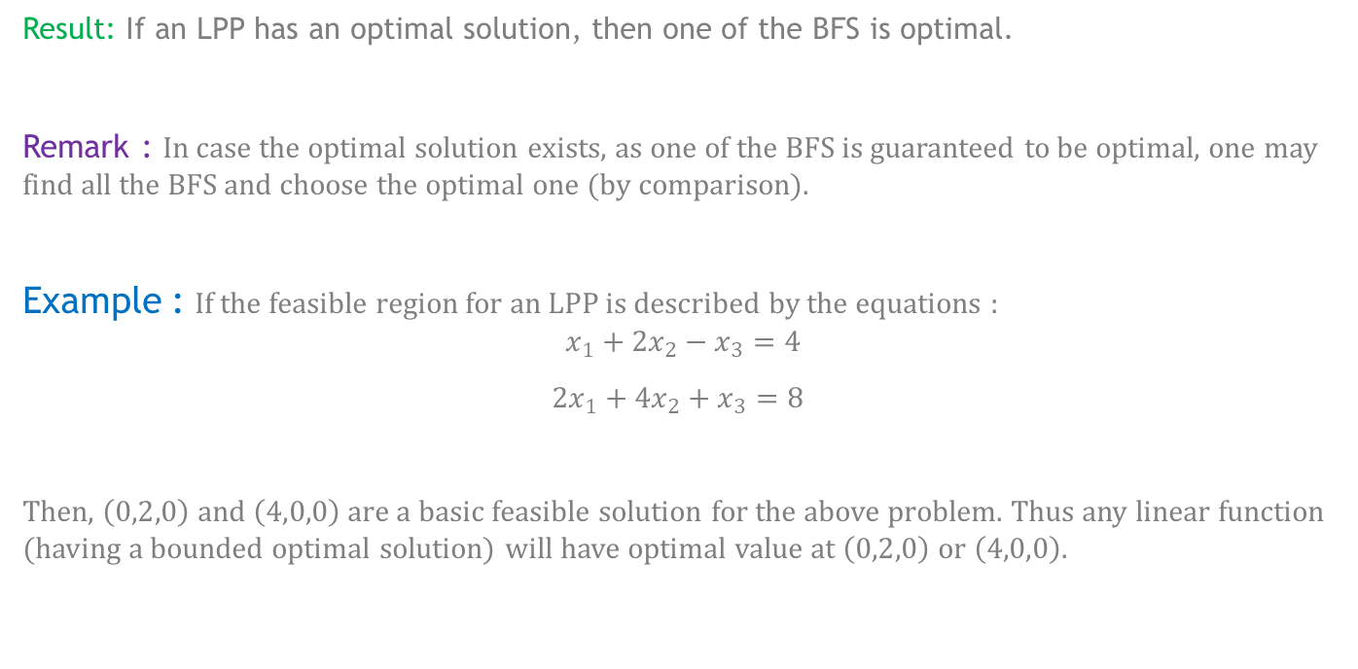
Optimal Solution using BFS
Result: If an LPP has an optimal solution, then one of the BFS is optimal.
Remark : In case the optimal solution exists, as one of the BFS is guaranteed to be optimal, one may find all the BFS and choose the optimal one (by comparison).
Example : If the feasible region for an LPP is described by the equations :
$$x_{1}+2x_{2}−x_{3}=4$$
$2x_{1}+4x_{2}+x_{3}=8$
Then, $\left(0,2,0\right)$ $and \left(4,0,0\right)$ are a basic feasible solution for the above problem. Thus any linear function (having a bounded optimal solution) will have optimal value at $\left(0,2,0\right)$ $or \left(4,0,0\right)$.

Slide 7

Optimal Solution using BFS
Example : $\max{x_{1}+2x_{2}}$ s.t.
$$x_{1}+x_{2}≤4$$
$2x_{1}+x_{2}≤6$
$x_{1},x_{2}≥0$
Then the above problem can be written as :
$\max{x_{1}+2x_{2}}$ s.t.
$$x_{1}+x_{2}+x_{3}=4$$
$2x_{1}+x_{2}+x_{4}=6$
$x_{1},x_{2},x_{3},x_{4}≥0$

Slide 8

Optimal Solution using BFS
Then,
$x_{1}=0,x_{2}=0⇒x_{3}=4, x_{4}=6$
$x_{1}=0,x_{3}=0⇒x_{2}=4, x_{4}=2$
$x_{1}=0,x_{4}=0⇒x_{2}=6, x_{3}=−2$ (not a BFS)
$x_{2}=0,x_{3}=0⇒x_{1}=4, x_{4}=−2$ (not a BFS)
$x_{2}=0,x_{4}=0⇒x_{1}=3, x_{3}=1$
$x_{3}=0,x_{4}=0⇒x_{1}=2, x_{2}=2$
Further, as $x_{1}=0,x_{2}=4$ yields the maximum value among the BFS, $(0,4)$ is the optimal solution to the given problem (with optimal value equal to 8).

Slide 9
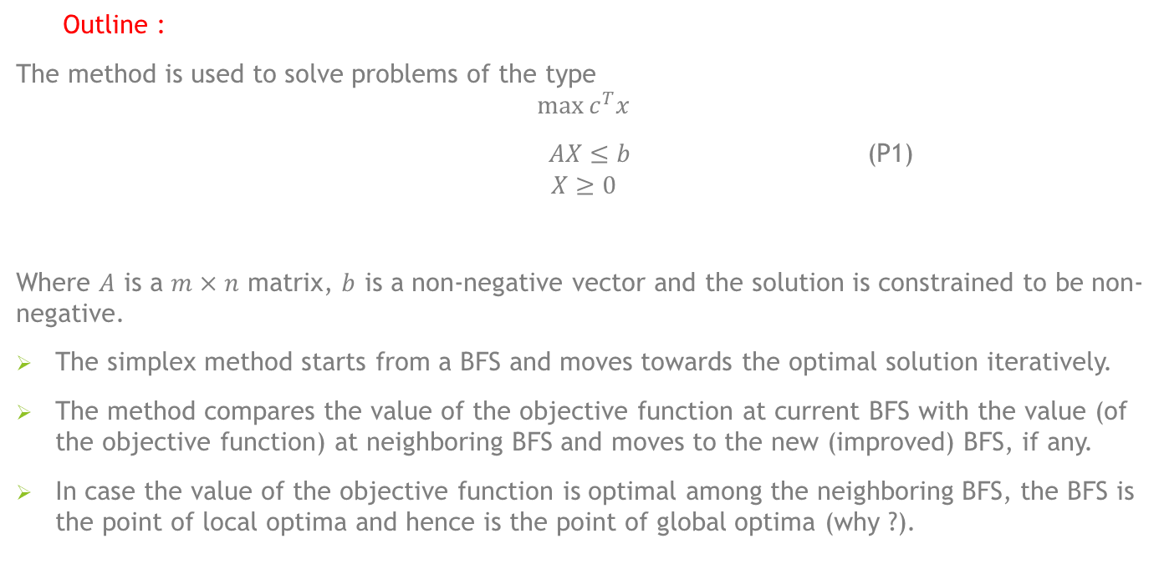
Simplex Method for solving LPP
Outline :
The method is used to solve problems of the type
$$\max{c^{T}x}$$
$AX≤b$ (P1)
$$X≥0$$
Where $A$ is a $m×n$ matrix, $b$ is a non-negative vector and the solution is constrained to be non-negative.
The simplex method starts from a BFS and moves towards the optimal solution iteratively.
The method compares the value of the objective function at current BFS with the value (of the objective function) at neighboring BFS and moves to the new (improved) BFS, if any.
In case the value of the objective function is optimal among the neighboring BFS, the BFS is the point of local optima and hence is the point of global optima (why ?).

Slide 10
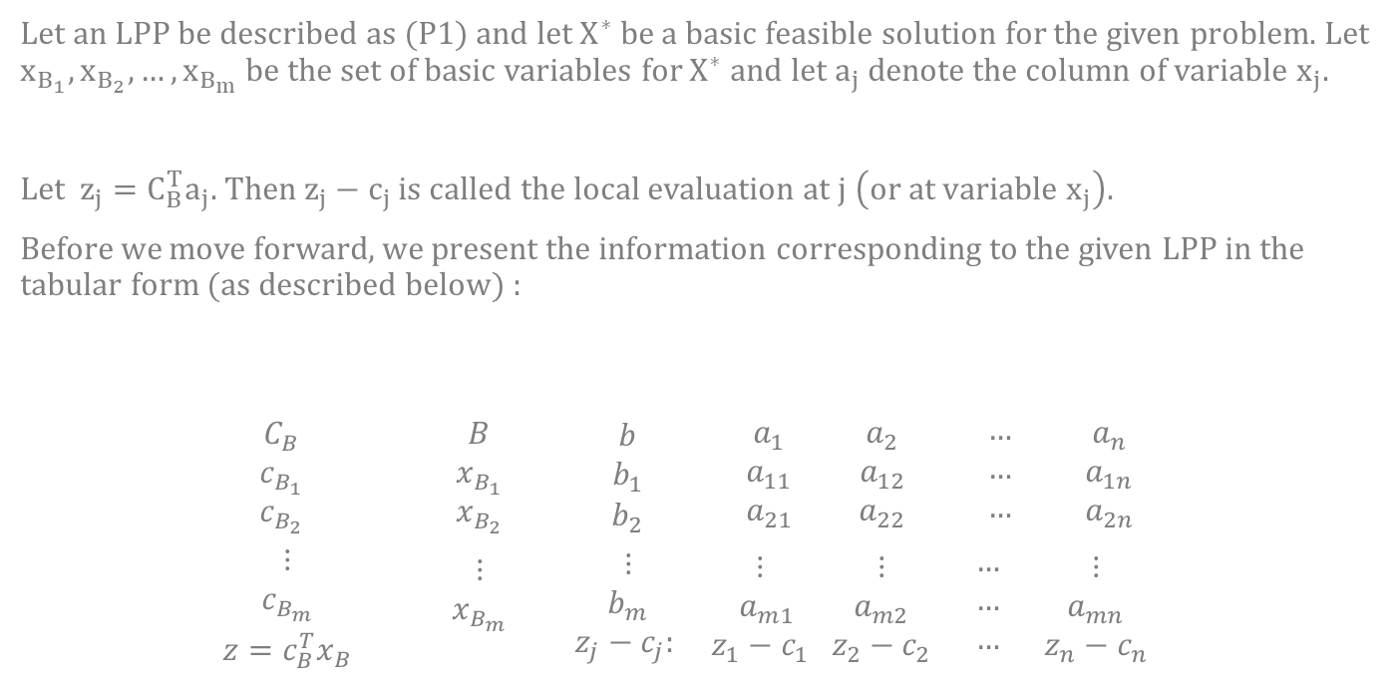
Some Useful Notions
Let an LPP be described as (P1) and let $X^{∗}$ be a basic feasible solution for the given problem. Let $x_{B_{1}},x_{B_{2}},…, x_{B_{m}}$ be the set of basic variables for $X^{∗}$and let $a_{j}$ denote the column of variable $x_{j}$.
Let $z_{j}=C_{B}^{T}a_{j}$. Then $z_{j}−c_{j}$ is called the local evaluation at $j \left(or at variable x_{j}\right).$
Before we move forward, we present the information corresponding to the given LPP in the tabular form (as described below) :
$$\begin{matrix}C_{B} \\ c_{B_{1}} \\ c_{B_{2}}\end{matrix} \begin{matrix}B \\ x_{B_{1}} \\ x_{B_{2}}\end{matrix} \begin{matrix}b \\ b_{1} \\ b_{2}\end{matrix} \begin{matrix}a_{1} \\ a_{11} \\ a_{21}\end{matrix} \begin{matrix}a_{2} \\ a_{12} \\ a_{22}\end{matrix} \begin{matrix}… \\ … \\ …\end{matrix} \begin{matrix}a_{n} \\ a_{1n} \\ a_{2n}\end{matrix}$$
$\begin{matrix}⋮ \\ c_{B_{m}} \\ z=c_{B}^{T}x_{B}\end{matrix} \begin{matrix}⋮ \\ x_{B_{m}} \\ \end{matrix}$ $\begin{matrix}⋮ \\ b_{m} \\ z_{j}−c_{j}: \end{matrix}$ $\begin{matrix}⋮ \\ a_{m1} \\ z_{1}−c_{1}\end{matrix} \begin{matrix}⋮ \\ a_{m2} \\ z_{2}−c_{2}\end{matrix} \begin{matrix}… \\ … \\ …\end{matrix} \begin{matrix}⋮ \\ a_{mn} \\ z_{n}−c_{n}\end{matrix}$

Slide 11
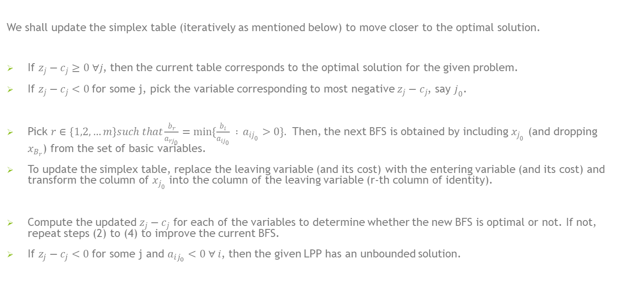
Methodology
We shall update the simplex table (iteratively as mentioned below) to move closer to the optimal solution.
If $z_{j}−c_{j}≥0 ∀j$, then the current table corresponds to the optimal solution for the given problem.
If $z_{j}−c_{j}<0$for some j, pick the variable corresponding to most negative $z_{j}−c_{j}$, say $j_{0}$.
Pick $r∈\left\{1,2,…m\right\}such that\frac{b_{r}}{a_{rj_{0}}}=\min{\{\frac{b_{i}}{a_{ij_{0}}} : }a_{ij_{0}}>0\}.$ Then, the next BFS is obtained by including $x_{j_{0}}$ (and dropping $x_{B_{r}}$) from the set of basic variables.
To update the simplex table, replace the leaving variable (and its cost) with the entering variable (and its cost) and transform the column of $x_{j_{0}}$ into the column of the leaving variable (r-th column of identity).
Compute the updated $z_{j}−c_{j}$ for each of the variables to determine whether the new BFS is optimal or not. If not, repeat steps (2) to (4) to improve the current BFS.
If $z_{j}−c_{j}<0$for some j and $a_{ij_{0}}<0 ∀ i$, then the given LPP has an unbounded solution.

Slide 12

Example
Example : $\max{{3x}_{1}+2x_{2}}$ s.t.
$$x_{1}+x_{2}≤4$$
$2x_{1}+x_{2}≤6$
$x_{1},x_{2}≥0$
Then the above problem can be written as :
$\max{{3x}_{1}+2x_{2}}$ s.t.
$$x_{1}+x_{2}+x_{3}=4$$
$2x_{1}+x_{2}+x_{4}=6$
$x_{1},x_{2},x_{3},x_{4}≥0$

Slide 13
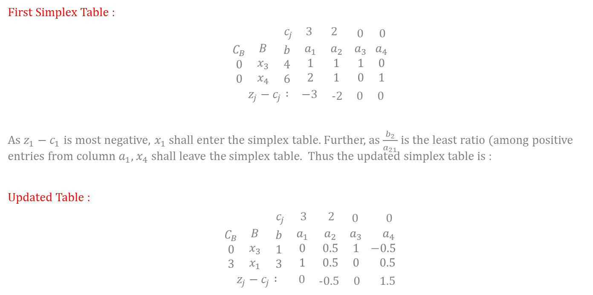
Example
First Simplex Table :
$\begin{matrix}c_{j} & 3 & 2\end{matrix} \begin{matrix}0 & 0\end{matrix}$
$\begin{matrix}C_{B} \\ 0 \\ 0\end{matrix}$ $\begin{matrix}B \\ x_{3} \\ x_{4}\end{matrix}$ $\begin{matrix}b \\ 4 \\ 6\end{matrix}$ $\begin{matrix}a_{1} \\ 1 \\ 2\end{matrix}$ $\begin{matrix}a_{2} \\ 1 \\ 1\end{matrix}$ $\begin{matrix}a_{3} \\ 1 \\ 0\end{matrix}$ $\begin{matrix}a_{4} \\ 0 \\ 1\end{matrix}$
$\begin{matrix}z_{j}−c_{j} : & −3\end{matrix}$ -2 0 0
As $z_{1}−c_{1}$ is most negative, $x_{1}$ shall enter the simplex table. Further, as $\frac{b_{2}}{a_{21}}$is the least ratio (among positive entries from column $a_{1}$, $x_{4}$ shall leave the simplex table. Thus the updated simplex table is :
Updated Table :
$\begin{matrix}{ c}_{j} & 3 & 2\end{matrix} 0$ 0
$\begin{matrix}C_{B} \\ 0 \\ 3\end{matrix}$ $\begin{matrix}B \\ x_{3} \\ x_{1}\end{matrix}$ $\begin{matrix}b \\ 1 \\ 3\end{matrix}$ $\begin{matrix}a_{1} \\ 0 \\ 1\end{matrix}$ $\begin{matrix}a_{2} \\ 0.5 \\ 0.5\end{matrix}$ $\begin{matrix}a_{3} \\ 1 \\ 0\end{matrix}$ $\begin{matrix}{ a}_{4} \\ −0.5 \\ 0.5\end{matrix}$
$\begin{matrix}z_{j}−c_{j} : & 0\end{matrix}$ -0.5 0 1.5

Slide 14
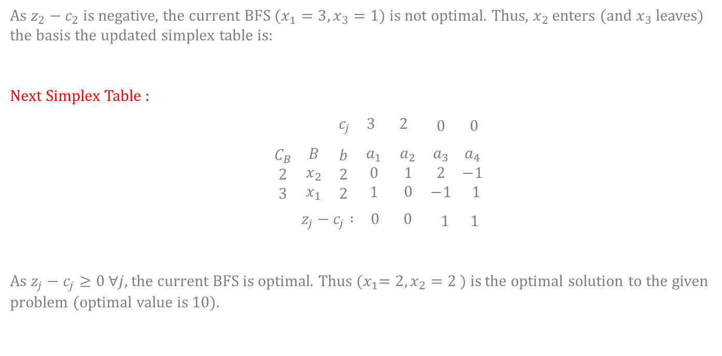
Example
As $z_{2}−c_{2}$ is negative, the current BFS ($x_{1}=3, x_{3}=1$) is not optimal. Thus, $x_{2}$ enters (and $x_{3}$ leaves) the basis the updated simplex table is:
Next Simplex Table :
$\begin{matrix}c_{j} & 3 & 2\end{matrix} 0 0$
$\begin{matrix}C_{B} \\ 2 \\ 3\end{matrix}$ $\begin{matrix}B \\ x_{2} \\ x_{1}\end{matrix}$ $\begin{matrix}b \\ 2 \\ 2\end{matrix}$ $\begin{matrix}a_{1} \\ 0 \\ 1\end{matrix}$ $\begin{matrix}a_{2} \\ 1 \\ 0\end{matrix}$ $\begin{matrix}a_{3} \\ 2 \\ −1\end{matrix}$ $\begin{matrix}a_{4} \\ −1 \\ 1\end{matrix}$
$\begin{matrix}z_{j}−c_{j} : & 0 & 0\end{matrix}$ 1 1
As $z_{j}−c_{j}≥0 ∀j$, the current BFS is optimal. Thus ${(x}_{1}=2,x_{2}=2 )$ is the optimal solution to the given problem (optimal value is 10).

Slide 15

Example
Example : $\max{{6x}_{1}−2x_{2}}$ s.t.
$${2x}_{1}−x_{2}≤2$$
$x_{1}≤4$
$x_{1},x_{2}≥0$
Then the above problem can be written as :
$\max{{6x}_{1}−2x_{2}}$ s.t.
$${2x}_{1}−x_{2}+x_{3}=2$$
${ x}_{1}+x_{4}=4$
$x_{1},x_{2},x_{3},x_{4}≥0$

Slide 16

Example
First Simplex Table :
$\begin{matrix}c_{j} & 6 & −2\end{matrix} \begin{matrix}0 & 0\end{matrix}$
$\begin{matrix}C_{B} \\ 0 \\ 0\end{matrix}$ $\begin{matrix}B \\ x_{3} \\ x_{4}\end{matrix}$ $\begin{matrix}b \\ 2 \\ 4\end{matrix}$ $\begin{matrix}a_{1} \\ 2 \\ 1\end{matrix}$ $\begin{matrix}a_{2} \\ −1 \\ 0\end{matrix}$ $\begin{matrix}a_{3} \\ 1 \\ 0\end{matrix}$ $\begin{matrix}a_{4} \\ 0 \\ 1\end{matrix}$
$\begin{matrix}z_{j}−c_{j} : & −6\end{matrix}$ 2 0 0
As $z_{1}−c_{1}$ is most negative, $x_{1}$ shall enter the simplex table. Further, as $\frac{b_{1}}{a_{11}}$is the least ratio (among positive entries from column $a_{1}$, $x_{3}$ shall leave the simplex table. Thus the updated simplex table is :
Updated Table :
$\begin{matrix}{ c}_{j} & 6 & − 2\end{matrix} 0$ 0
$\begin{matrix}C_{B} \\ 6 \\ 0\end{matrix}$ $\begin{matrix}B \\ x_{1} \\ x_{4}\end{matrix}$ $\begin{matrix}b \\ 1 \\ 3\end{matrix}$ $\begin{matrix}a_{1} \\ 1 \\ 0\end{matrix}$ $−\begin{matrix}a_{2} \\ 0.5 \\ 0.5\end{matrix}$ $\begin{matrix}{ a}_{3} \\ 0.5 \\ −0.5\end{matrix}$ $\begin{matrix}{ a}_{4} \\ 0 \\ 1\end{matrix}$
$\begin{matrix}z_{j}−c_{j} : & 0\end{matrix}$ -1 3 0

Slide 17
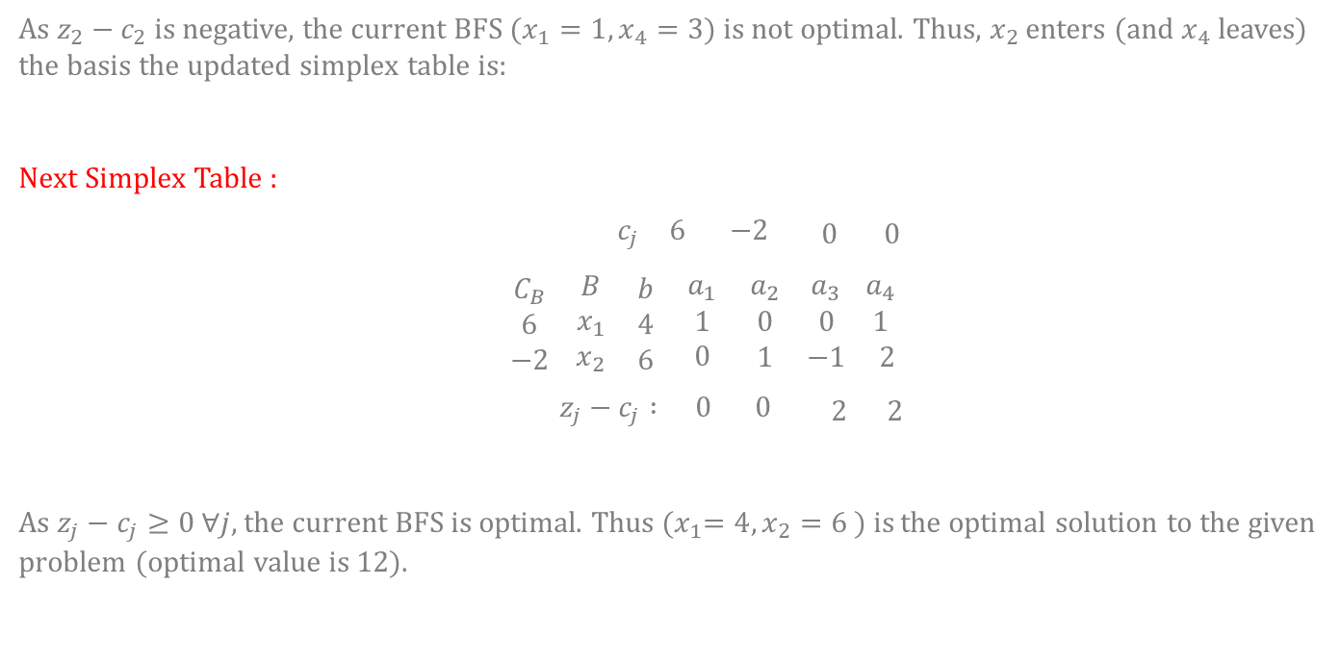
Example
As $z_{2}−c_{2}$ is negative, the current BFS ($x_{1}=1, x_{4}=3$) is not optimal. Thus, $x_{2}$ enters (and $x_{4}$ leaves) the basis the updated simplex table is:
Next Simplex Table :
$\begin{matrix}c_{j} & 6 & −2\end{matrix} 0 0$
$\begin{matrix}C_{B} \\ 6 \\ −2\end{matrix}$ $\begin{matrix}B \\ x_{1} \\ x_{2}\end{matrix}$ $\begin{matrix}b \\ 4 \\ 6\end{matrix}$ $\begin{matrix}a_{1} \\ 1 \\ 0\end{matrix}$ $\begin{matrix}a_{2} \\ 0 \\ 1\end{matrix}$ $\begin{matrix}a_{3} \\ 0 \\ −1\end{matrix}$ $\begin{matrix}a_{4} \\ 1 \\ 2\end{matrix}$
$\begin{matrix}z_{j}−c_{j} : & 0 & 0\end{matrix}$ 2 2
As $z_{j}−c_{j}≥0 ∀j$, the current BFS is optimal. Thus ${(x}_{1}=4,x_{2}=6 )$ is the optimal solution to the given problem (optimal value is 12).

Slide 18
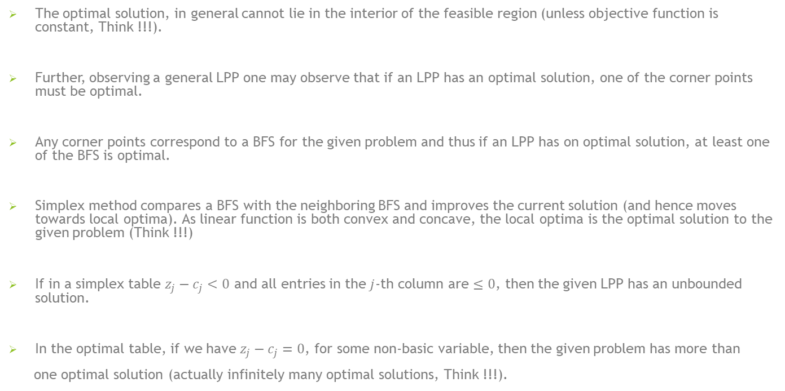
Some Remarks
The optimal solution, in general cannot lie in the interior of the feasible region (unless objective function is constant, Think !!!).
Further, observing a general LPP one may observe that if an LPP has an optimal solution, one of the corner points must be optimal.
Any corner points correspond to a BFS for the given problem and thus if an LPP has on optimal solution, at least one of the BFS is optimal.
Simplex method compares a BFS with the neighboring BFS and improves the current solution (and hence moves towards local optima). As linear function is both convex and concave, the local optima is the optimal solution to the given problem (Think !!!)
If in a simplex table $z_{j}−c_{j}<0$ and all entries in the $j$-th column are $≤0$, then the given LPP has an unbounded solution.
In the optimal table, if we have $z_{j}−c_{j}=0$, for some non-basic variable, then the given problem has more than
one optimal solution (actually infinitely many optimal solutions, Think !!!).

Slide 19
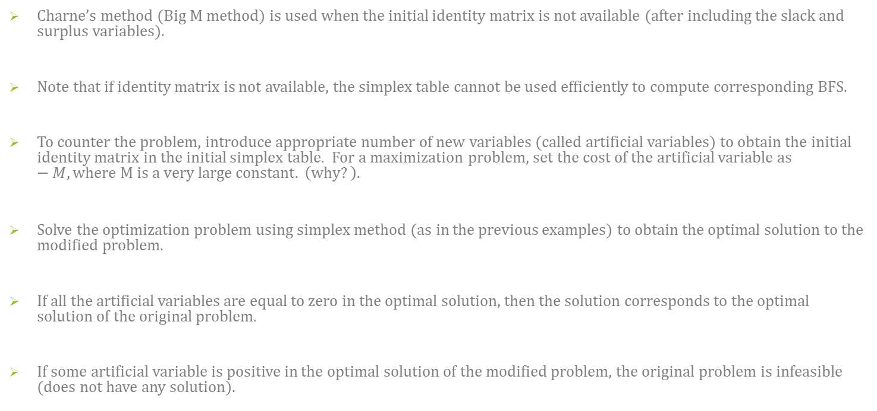
Charne’s Method for finding Solution to an LPP
Charne’s method (Big M method) is used when the initial identity matrix is not available (after including the slack and surplus variables).
Note that if identity matrix is not available, the simplex table cannot be used efficiently to compute corresponding BFS.
To counter the problem, introduce appropriate number of new variables (called artificial variables) to obtain the initial identity matrix in the initial simplex table. For a maximization problem, set the cost of the artificial variable as $−M,where M is a very large constant. \left(why?\right).$
Solve the optimization problem using simplex method (as in the previous examples) to obtain the optimal solution to the modified problem.
If all the artificial variables are equal to zero in the optimal solution, then the solution corresponds to the optimal solution of the original problem.
If some artificial variable is positive in the optimal solution of the modified problem, the original problem is infeasible (does not have any solution).

Slide 20

Example
Example : $\min{{2x}_{1}+x_{2}}$ s.t.
$$3x_{1}+x_{2}=3$$
$4x_{1}+3x_{2}≥6$
$$x_{1}+2x_{2}≤3$$
$$x_{1},x_{2}≥0$$
Then the above problem can be written as :
$\max{{−2x}_{1}−x_{2}}$ s.t.
$$3x_{1}+x_{2} =3$$
$4x_{1}+3x_{2}−x_{3} =6$
$$x_{1}+2x_{2}+x_{4} =3$$
$$x_{1},x_{2}≥0$$

Slide 21
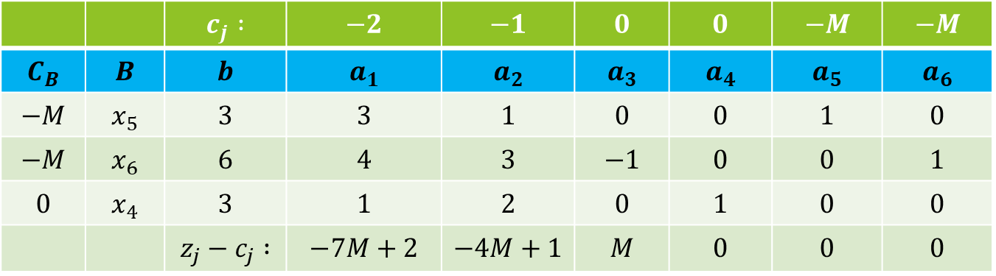
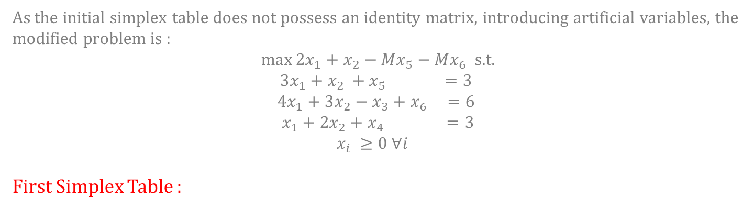
Example :
As the initial simplex table does not possess an identity matrix, introducing artificial variables, the modified problem is :
$\max{{2x}_{1}+x_{2}−Mx_{5}−Mx_{6}}$ s.t.
$$3x_{1}+x_{2} +x_{5} =3$$
$$4x_{1}+3x_{2}−x_{3}+x_{6} =6$$
$$x_{1}+2x_{2}+x_{4} =3$$
$$x_{i} ≥0 ∀i$$
First Simplex Table :
 |  | $$c_{j} :$$ | $$−2$$ | $$−1$$ | $$0$$ | $$0$$ | $$−M$$ | $$−M$$
$$C_{B}$$ | $$B$$ | $$b$$ | $$a_{1}$$ | $$a_{2}$$ | $$a_{3}$$ | $$a_{4}$$ | $$a_{5}$$ | $$a_{6}$$
$$−M$$ | $$x_{5}$$ | $$3$$ | $$3$$ | $$1$$ | $$0$$ | $$0$$ | $$1$$ | $$0$$
$$−M$$ | $$x_{6}$$ | $$6$$ | $$4$$ | $$3$$ | $$−1$$ | $$0$$ | $$0$$ | $$1$$
$$0$$ | $$x_{4}$$ | $$3$$ | $$1$$ | $$2$$ | $$0$$ | $$1$$ | $$0$$ | $$0$$
 |  | $$z_{j}−c_{j} :$$ | $$−7M+2$$ | $$−4M+1$$ | $$M$$ | $$0$$ | $$0$$ | $$0$$

Slide 22
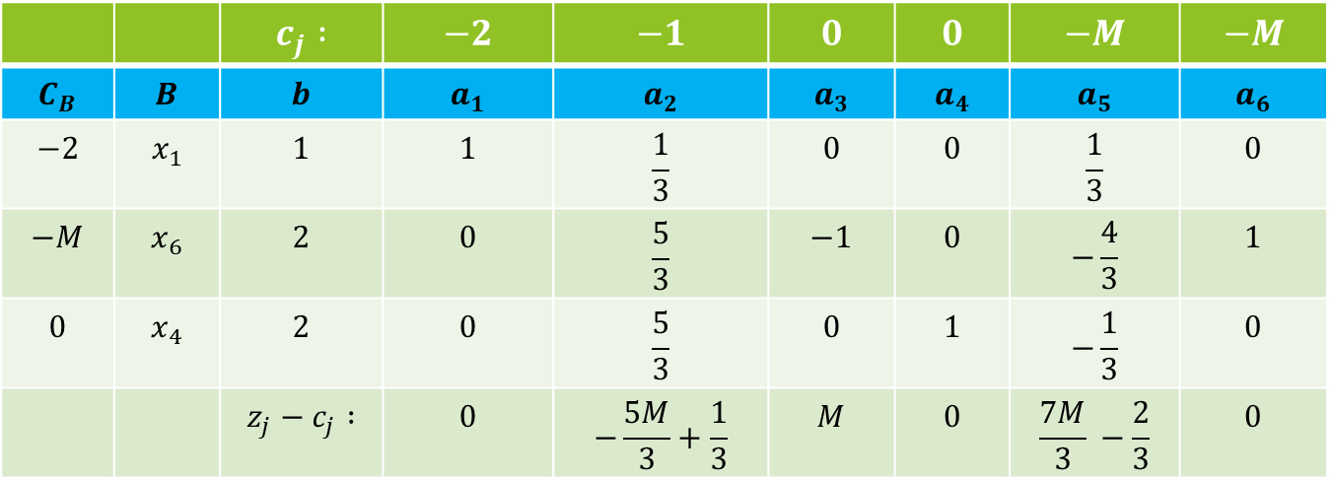
Example :
As $z_{1}−c_{1}$is most negative, $x_{1}$ enters the basis. Further as $\frac{b_{1}}{a_{21}}$ is least among the positive ratios, $x_{5}$ leaves the basis. Thus the updated simplex table is :
 |  | $$c_{j} :$$ | $$−2$$ | $$−1$$ | $$0$$ | $$0$$ | $$−M$$ | $$−M$$
$$C_{B}$$ | $$B$$ | $$b$$ | $$a_{1}$$ | $$a_{2}$$ | $$a_{3}$$ | $$a_{4}$$ | $$a_{5}$$ | $$a_{6}$$
$$−2$$ | $$x_{1}$$ | $$1$$ | $$1$$ | $$\frac{1}{3}$$ | $$0$$ | $$0$$ | $$\frac{1}{3}$$ | $$0$$
$$−M$$ | $$x_{6}$$ | $$2$$ | $$0$$ | $$\frac{5}{3}$$ | $$−1$$ | $$0$$ | $$−\frac{4}{3}$$ | $$1$$
$$0$$ | $$x_{4}$$ | $$2$$ | $$0$$ | $$\frac{5}{3}$$ | $$0$$ | $$1$$ | $$−\frac{1}{3}$$ | $$0$$
 |  | $$z_{j}−c_{j} :$$ | $$0$$ | $$−\frac{5M}{3}+\frac{1}{3}$$ | $$M$$ | $$0$$ | $$\frac{7M}{3} −\frac{2}{3}$$ | $$0$$

Slide 23
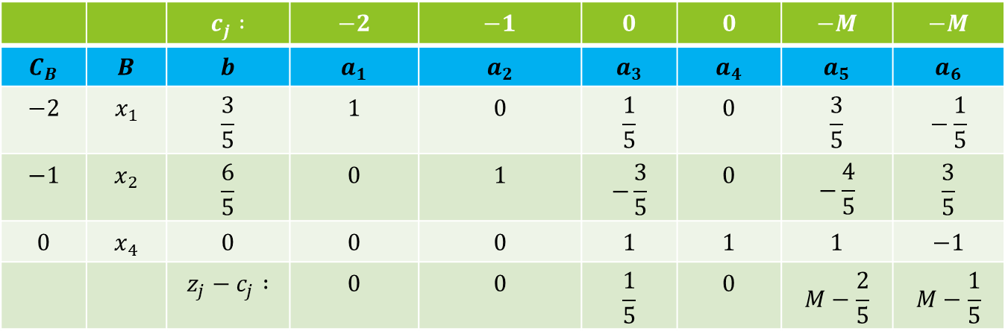
Example :
Again, as $z_{2}−c_{2}$is most negative, $x_{2}$ enters the basis. Further as $\frac{b_{2}}{a_{22}}$ is least among the positive ratios, $x_{6}$ leaves the basis. Thus the updated simplex table is :
 |  | $$c_{j} :$$ | $$−2$$ | $$−1$$ | $$0$$ | $$0$$ | $$−M$$ | $$−M$$
$$C_{B}$$ | $$B$$ | $$b$$ | $$a_{1}$$ | $$a_{2}$$ | $$a_{3}$$ | $$a_{4}$$ | $$a_{5}$$ | $$a_{6}$$
$$−2$$ | $$x_{1}$$ | $$\frac{3}{5}$$ | $$1$$ | $$0$$ | $$\frac{1}{5}$$ | $$0$$ | $$\frac{3}{5}$$ | $$−\frac{1}{5}$$
$$−1$$ | $$x_{2}$$ | $$\frac{6}{5}$$ | $$0$$ | $$1$$ | $$−\frac{3}{5}$$ | $$0$$ | $$−\frac{4}{5}$$ | $$\frac{3}{5}$$
$$0$$ | $$x_{4}$$ | $$0$$ | $$0$$ | $$0$$ | $$1$$ | $$1$$ | $$1$$ | $$−1$$
 |  | $$z_{j}−c_{j} :$$ | $$0$$ | $$0$$ | $$\frac{1}{5}$$ | $$0$$ | $$M−\frac{2}{5}$$ | $$M−\frac{1}{5}$$
As $z_{j}−c_{j}≥0 ∀ j$, (and all artificial variables are zero), the current solution is optimal for the given problem. Thus optimal solution is $x_{1}=\frac{3}{5}, x_{2}=\frac{6}{5}$ and optimal value is $\frac{12}{5}$.

Slide 24

Example
Example : $\min{{3x}_{1}+{2x}_{2}}$ s.t.
$$2x_{1}+x_{2}≤2$$
$3x_{1}+4x_{2}≥12$
$$x_{1},x_{2}≥0$$
Then the above problem can be written as :
$\max{{3x}_{1}+2x_{2}}$ s.t.
$$2x_{1}+x_{2}+x_{3}=2$$
$3x_{1}+4x_{2}−x_{4}=12$
$$x_{1},x_{2}≥0$$

Slide 25
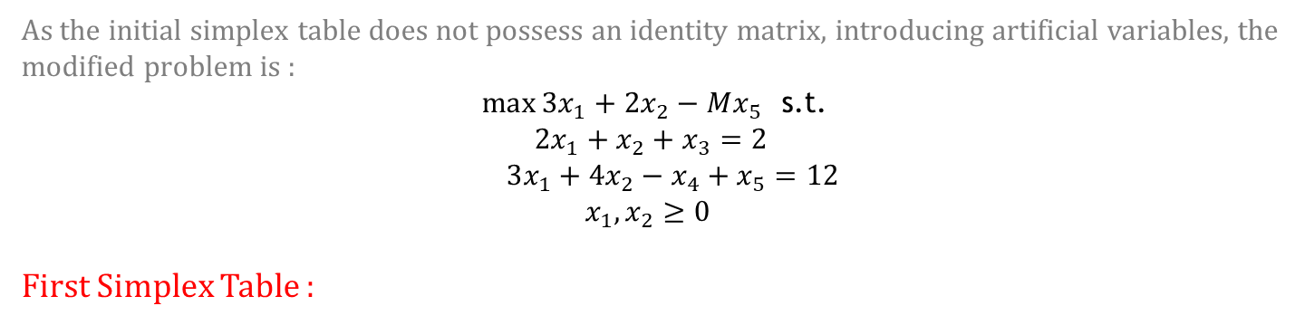
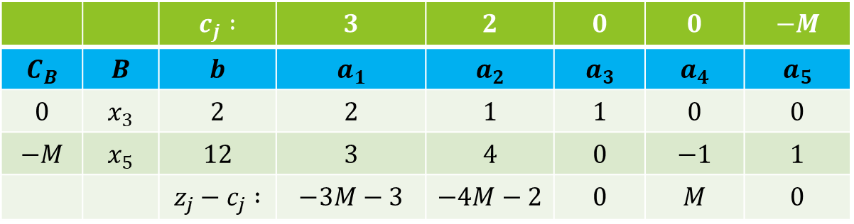
Example :
As the initial simplex table does not possess an identity matrix, introducing artificial variables, the modified problem is :
$\max{{3x}_{1}+2x_{2}−Mx_{5}}$ s.t.
$$2x_{1}+x_{2}+x_{3}=2$$
$3x_{1}+4x_{2}−x_{4}+x_{5}=12$
$$x_{1},x_{2}≥0$$
First Simplex Table :
 |  | $$c_{j} :$$ | $$3$$ | $$2$$ | $$0$$ | $$0$$ | $$−M$$
$$C_{B}$$ | $$B$$ | $$b$$ | $$a_{1}$$ | $$a_{2}$$ | $$a_{3}$$ | $$a_{4}$$ | $$a_{5}$$
$$0$$ | $$x_{3}$$ | $$2$$ | $$2$$ | $$1$$ | $$1$$ | $$0$$ | $$0$$
$$−M$$ | $$x_{5}$$ | $$12$$ | $$3$$ | $$4$$ | $$0$$ | $$−1$$ | $$1$$
 |  | $$z_{j}−c_{j} :$$ | $$−3M−3$$ | $$−4M−2$$ | $$0$$ | $$M$$ | $$0$$

Slide 26
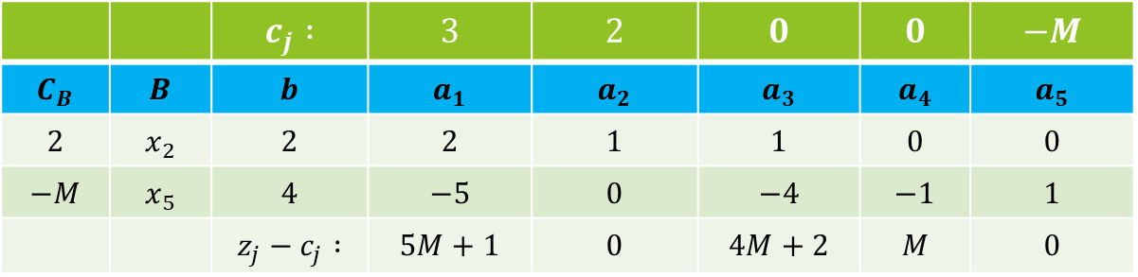
Example :
As $z_{2}−c_{2}$is most negative, $x_{2}$ enters the basis. Further as $\frac{b_{1}}{a_{21}}$ is least among the positive ratios, $x_{3}$ leaves the basis. Thus the updated simplex table is :
 |  | $$c_{j} :$$ | $$3$$ | $$2$$ | $$0$$ | $$0$$ | $$−M$$
$$C_{B}$$ | $$B$$ | $$b$$ | $$a_{1}$$ | $$a_{2}$$ | $$a_{3}$$ | $$a_{4}$$ | $$a_{5}$$
$$2$$ | $$x_{2}$$ | $$2$$ | $$2$$ | $$1$$ | $$1$$ | $$0$$ | $$0$$
$$−M$$ | $$x_{5}$$ | $$4$$ | $$−5$$ | $$0$$ | $$−4$$ | $$−1$$ | $$1$$
 |  | $$z_{j}−c_{j} :$$ | $$5M+1$$ | $$0$$ | $$4M+2$$ | $$M$$ | $$0$$
As $z_{j}−c_{j}≥0 ∀ j$and there is an artificial variable in the optimal solution at non-zero level (value), the given problem is infeasible (feasible region is empty).

Slide 27
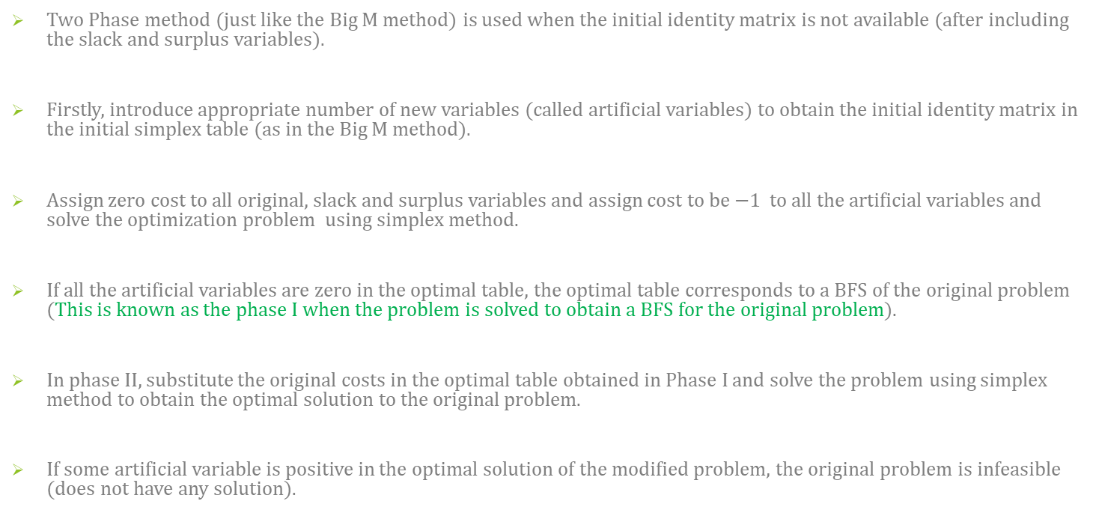
Two phase Method for finding Solution to an LPP
Two Phase method (just like the Big M method) is used when the initial identity matrix is not available (after including the slack and surplus variables).
Firstly, introduce appropriate number of new variables (called artificial variables) to obtain the initial identity matrix in the initial simplex table (as in the Big M method).
Assign zero cost to all original, slack and surplus variables and assign cost to be $−1$ to all the artificial variables and solve the optimization problem using simplex method.
If all the artificial variables are zero in the optimal table, the optimal table corresponds to a BFS of the original problem (This is known as the phase I when the problem is solved to obtain a BFS for the original problem).
In phase II, substitute the original costs in the optimal table obtained in Phase I and solve the problem using simplex method to obtain the optimal solution to the original problem.
If some artificial variable is positive in the optimal solution of the modified problem, the original problem is infeasible (does not have any solution).

Slide 28
Example
Example : $\min{{2x}_{1}+x_{2}}$ s.t.
$$3x_{1}+x_{2}=3$$
$4x_{1}+3x_{2}≥6$
$$x_{1}+2x_{2}≤3$$
$$x_{1},x_{2}≥0$$
Then the above problem can be written as :
$\max{{−2x}_{1}−x_{2}}$ s.t.
$$3x_{1}+x_{2} =3$$
$4x_{1}+3x_{2}−x_{3} =6$
$$x_{1}+2x_{2}+x_{4} =3$$
$$x_{1},x_{2}≥0$$

Slide 29
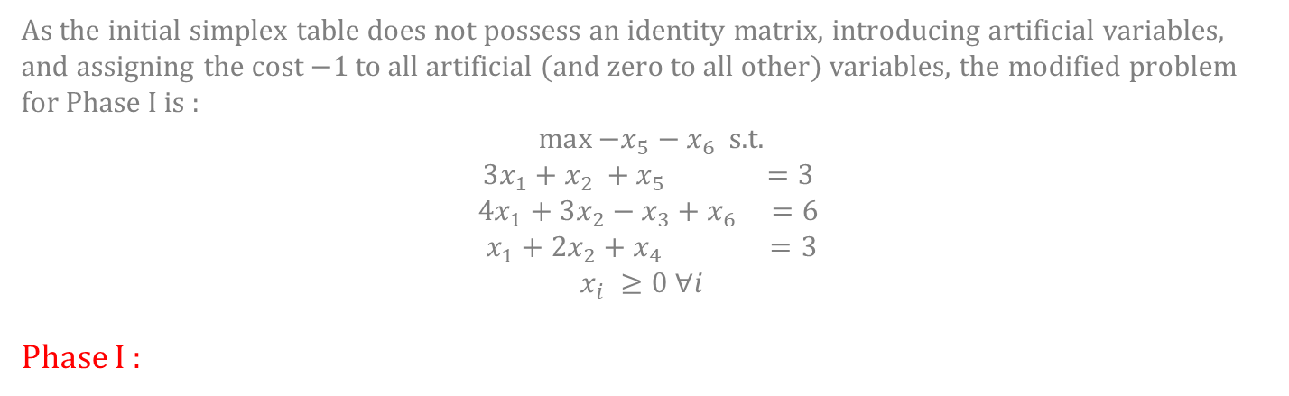
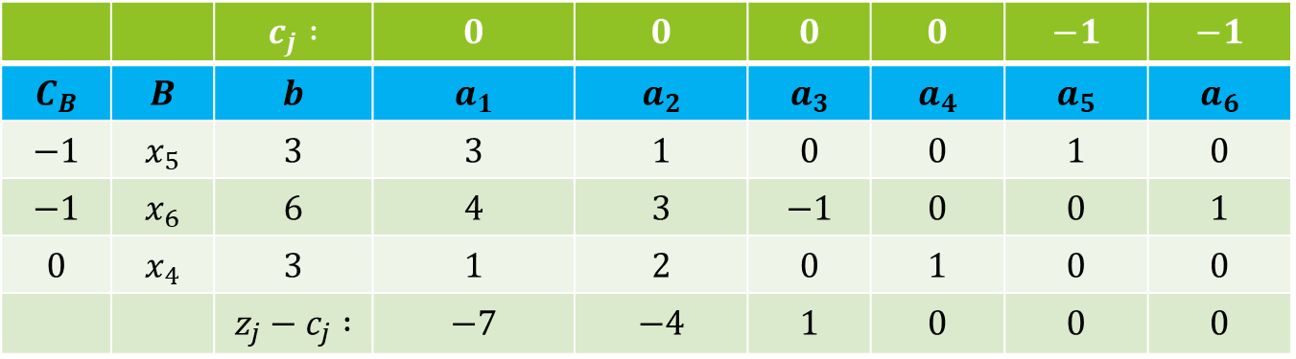
Example :
As the initial simplex table does not possess an identity matrix, introducing artificial variables, and assigning the cost $−1$ to all artificial (and zero to all other) variables, the modified problem for Phase I is :
$\max{−x_{5}−x_{6}}$ s.t.
$$3x_{1}+x_{2} +x_{5} =3$$
$$4x_{1}+3x_{2}−x_{3}+x_{6} =6$$
$$x_{1}+2x_{2}+x_{4} =3$$
$$x_{i} ≥0 ∀i$$
Phase I :
 |  | $$c_{j} :$$ | $$0$$ | $$0$$ | $$0$$ | $$0$$ | $$−1$$ | $$−1$$
$$C_{B}$$ | $$B$$ | $$b$$ | $$a_{1}$$ | $$a_{2}$$ | $$a_{3}$$ | $$a_{4}$$ | $$a_{5}$$ | $$a_{6}$$
$$−1$$ | $$x_{5}$$ | $$3$$ | $$3$$ | $$1$$ | $$0$$ | $$0$$ | $$1$$ | $$0$$
$$−1$$ | $$x_{6}$$ | $$6$$ | $$4$$ | $$3$$ | $$−1$$ | $$0$$ | $$0$$ | $$1$$
$$0$$ | $$x_{4}$$ | $$3$$ | $$1$$ | $$2$$ | $$0$$ | $$1$$ | $$0$$ | $$0$$
 |  | $$z_{j}−c_{j} :$$ | $$−7$$ | $$−4$$ | $$1$$ | $$0$$ | $$0$$ | $$0$$

Slide 30
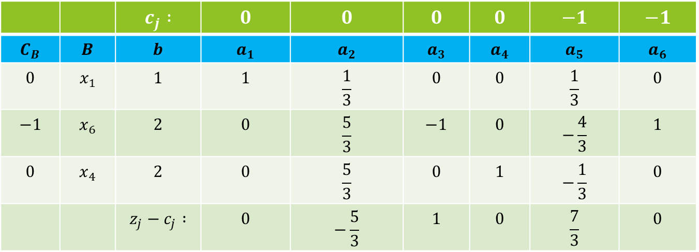
Example :
As $z_{1}−c_{1}$is most negative, $x_{1}$ enters the basis. Further as $\frac{b_{1}}{a_{21}}$ is least among the positive ratios, $x_{5}$ leaves the basis. Thus the updated simplex table is :
 |  | $$c_{j} :$$ | $$0$$ | $$0$$ | $$0$$ | $$0$$ | $$−1$$ | $$−1$$
$$C_{B}$$ | $$B$$ | $$b$$ | $$a_{1}$$ | $$a_{2}$$ | $$a_{3}$$ | $$a_{4}$$ | $$a_{5}$$ | $$a_{6}$$
$$0$$ | $$x_{1}$$ | $$1$$ | $$1$$ | $$\frac{1}{3}$$ | $$0$$ | $$0$$ | $$\frac{1}{3}$$ | $$0$$
$$−1$$ | $$x_{6}$$ | $$2$$ | $$0$$ | $$\frac{5}{3}$$ | $$−1$$ | $$0$$ | $$−\frac{4}{3}$$ | $$1$$
$$0$$ | $$x_{4}$$ | $$2$$ | $$0$$ | $$\frac{5}{3}$$ | $$0$$ | $$1$$ | $$−\frac{1}{3}$$ | $$0$$
 |  | $$z_{j}−c_{j} :$$ | $$0$$ | $$−\frac{5}{3}$$ | $$1$$ | $$0$$ | $$\frac{7}{3}$$ | $$0$$

Slide 31
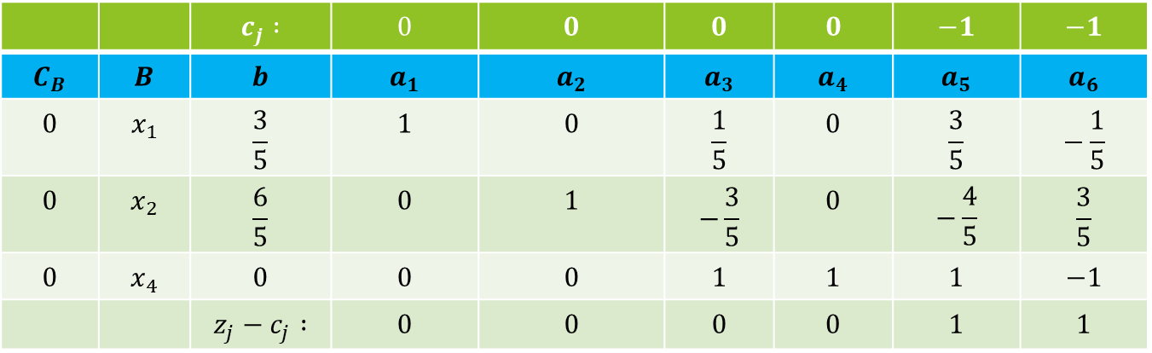
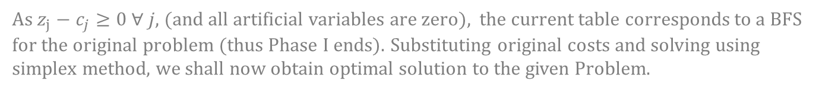
Example :
Again, as $z_{2}−c_{2}$is most negative, $x_{2}$ enters the basis. Further as $\frac{b_{2}}{a_{22}}$ is least among the positive ratios, $x_{6}$ leaves the basis. Thus the updated simplex table is :
 |  | $$c_{j} :$$ | $$0$$ | $$0$$ | $$0$$ | $$0$$ | $$−1$$ | $$−1$$
$$C_{B}$$ | $$B$$ | $$b$$ | $$a_{1}$$ | $$a_{2}$$ | $$a_{3}$$ | $$a_{4}$$ | $$a_{5}$$ | $$a_{6}$$
$$0$$ | $$x_{1}$$ | $$\frac{3}{5}$$ | $$1$$ | $$0$$ | $$\frac{1}{5}$$ | $$0$$ | $$\frac{3}{5}$$ | $$−\frac{1}{5}$$
$$0$$ | $$x_{2}$$ | $$\frac{6}{5}$$ | $$0$$ | $$1$$ | $$−\frac{3}{5}$$ | $$0$$ | $$−\frac{4}{5}$$ | $$\frac{3}{5}$$
$$0$$ | $$x_{4}$$ | $$0$$ | $$0$$ | $$0$$ | $$1$$ | $$1$$ | $$1$$ | $$−1$$
 |  | $$z_{j}−c_{j} :$$ | $$0$$ | $$0$$ | $$0$$ | $$0$$ | $$1$$ | $$1$$
As $z_{j}−c_{j}≥0 ∀ j$, (and all artificial variables are zero), the current table corresponds to a BFS for the original problem (thus Phase I ends). Substituting original costs and solving using simplex method, we shall now obtain optimal solution to the given Problem.

Slide 32
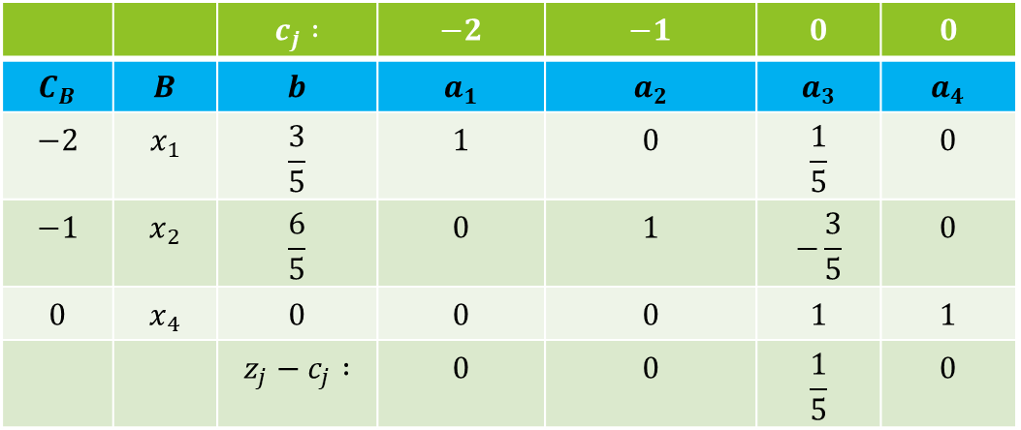
Example :
Phase II :
 |  | $$c_{j} :$$ | $$−2$$ | $$−1$$ | $$0$$ | $$0$$
$$C_{B}$$ | $$B$$ | $$b$$ | $$a_{1}$$ | $$a_{2}$$ | $$a_{3}$$ | $$a_{4}$$
$$−2$$ | $$x_{1}$$ | $$\frac{3}{5}$$ | $$1$$ | $$0$$ | $$\frac{1}{5}$$ | $$0$$
$$−1$$ | $$x_{2}$$ | $$\frac{6}{5}$$ | $$0$$ | $$1$$ | $$−\frac{3}{5}$$ | $$0$$
$$0$$ | $$x_{4}$$ | $$0$$ | $$0$$ | $$0$$ | $$1$$ | $$1$$
 |  | $$z_{j}−c_{j} :$$ | $$0$$ | $$0$$ | $$\frac{1}{5}$$ | $$0$$
As $z_{j}−c_{j}≥0 ∀ j$, the current solution is optimal for the given problem. Thus optimal solution is $x_{1}=\frac{3}{5}, x_{2}=\frac{6}{5}$ and optimal value is $\frac{12}{5}$.

Slide 33
Example
Example : $\min{{3x}_{1}+{2x}_{2}}$ s.t.
$$2x_{1}+x_{2}≤2$$
$3x_{1}+4x_{2}≥12$
$$x_{1},x_{2}≥0$$
Then the above problem can be written as :
$\max{{3x}_{1}+2x_{2}}$ s.t.
$$2x_{1}+x_{2}+x_{3}=2$$
$3x_{1}+4x_{2}−x_{4}=12$
$$x_{1},x_{2}≥0$$

Slide 34
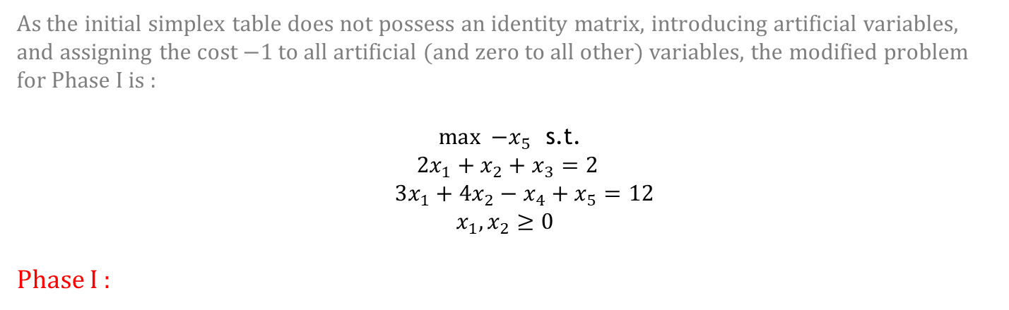
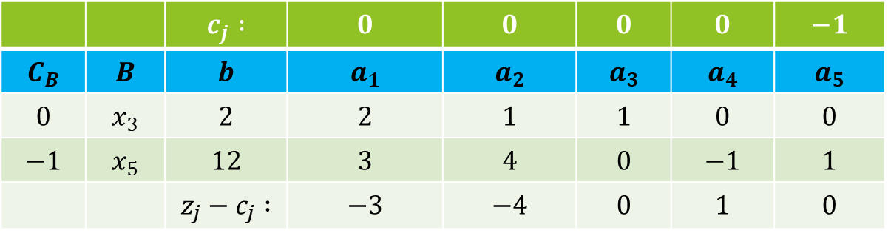
Example :
As the initial simplex table does not possess an identity matrix, introducing artificial variables, and assigning the cost $−1$ to all artificial (and zero to all other) variables, the modified problem for Phase I is :
$\max{ −x_{5}}$ s.t.
$$2x_{1}+x_{2}+x_{3}=2$$
$3x_{1}+4x_{2}−x_{4}+x_{5}=12$
$$x_{1},x_{2}≥0$$
Phase I :
 |  | $$c_{j} :$$ | $$0$$ | $$0$$ | $$0$$ | $$0$$ | $$−1$$
$$C_{B}$$ | $$B$$ | $$b$$ | $$a_{1}$$ | $$a_{2}$$ | $$a_{3}$$ | $$a_{4}$$ | $$a_{5}$$
$$0$$ | $$x_{3}$$ | $$2$$ | $$2$$ | $$1$$ | $$1$$ | $$0$$ | $$0$$
$$−1$$ | $$x_{5}$$ | $$12$$ | $$3$$ | $$4$$ | $$0$$ | $$−1$$ | $$1$$
 |  | $$z_{j}−c_{j} :$$ | $$−3$$ | $$−4$$ | $$0$$ | $$1$$ | $$0$$

Slide 35
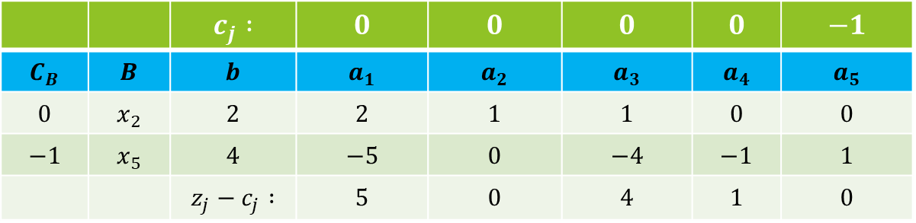
Example :
As $z_{2}−c_{2}$ is most negative, $x_{2}$ enters the basis. Further as $\frac{b_{1}}{a_{21}}$ is least among the positive ratios, $x_{3}$ leaves the basis. Thus the updated simplex table is :
 |  | $$c_{j} :$$ | $$0$$ | $$0$$ | $$0$$ | $$0$$ | $$−1$$
$$C_{B}$$ | $$B$$ | $$b$$ | $$a_{1}$$ | $$a_{2}$$ | $$a_{3}$$ | $$a_{4}$$ | $$a_{5}$$
$$0$$ | $$x_{2}$$ | $$2$$ | $$2$$ | $$1$$ | $$1$$ | $$0$$ | $$0$$
$$−1$$ | $$x_{5}$$ | $$4$$ | $$−5$$ | $$0$$ | $$−4$$ | $$−1$$ | $$1$$
 |  | $$z_{j}−c_{j} :$$ | $$5$$ | $$0$$ | $$4$$ | $$1$$ | $$0$$
As $z_{j}−c_{j}≥0 ∀ j$and there is an artificial variable in the optimal solution at non-zero level (value), the given problem is infeasible (feasible region is empty).

Slide 36
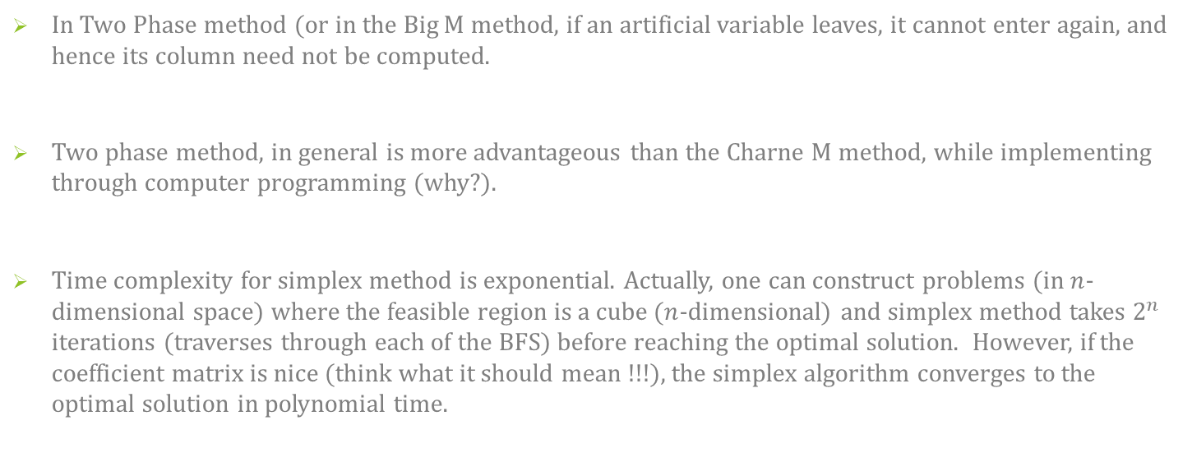
Some Remarks
In Two Phase method (or in the Big M method, if an artificial variable leaves, it cannot enter again, and hence its column need not be computed.
Two phase method, in general is more advantageous than the Charne M method, while implementing through computer programming (why?).
Time complexity for simplex method is exponential. Actually, one can construct problems (in $n$-dimensional space) where the feasible region is a cube ($n$-dimensional) and simplex method takes $2^{n}$ iterations (traverses through each of the BFS) before reaching the optimal solution. However, if the coefficient matrix is nice (think what it should mean !!!), the simplex algorithm converges to the optimal solution in polynomial time.

